Slide 1
Principles of Management and Applied Economics
www.hndit.com
1. Introduction to Management

Slide 2
Contents
www.hndit.com
What is management?
Management as a process
Management is an Art or a Science?
Core concepts of management
Why management?
Who is a Manager?
Managerial roles

Slide 3
www.hndit.com
Management in Business Organisations
Business
Management
Organisation

Slide 4
What is Management? There is no universally accepted definition of Management.
www.hndit.com

Slide 5
www.hndit.com
Different Definitions of Management

Slide 6
Management Definitions
www.hndit.com
Definition – 1
Management is the art of getting things done through
other people.
Mary Parker Follet (1868-1933)
Definition – 2
Management is the art of getting things done through and with people in formally organized group.
(Koontz)

Slide 7
Management Definitions
www.hndit.com
Definition – 3
Management is the process of planning, organising, commanding, coordinating and controlling.
(Fayol,1930)
Definition – 4
Management is the process of planning, organising, leading and controlling, the efforts of organisation members and of using all other organisational resources to achieve organisational goals.
(Stoner and Freeman,2009)

Slide 8
Management Definitions
www.hndit.com
Definition – 5
Management is the attainment of organisational goals in an effective and efficient manner through planning, organising, leading and controlling organisational resources.
(Daft,2012)

Slide 9
www.hndit.com
Hence, Management can be broadly defined as a process of planning, organising, leading and controlling the limited resources efficiently and effectively to achieve predetermined goals and objectives in an ever changing business environment.

Slide 10
Management in Organisations
www.hndit.com
Environment
Planning
Organizing
Inputs from the environment
•
Human resources
Goals Attained
•
Financial resources
•
Efficiently
•
Physical resources
•
Effectively
•
Information resources
Controlling
Leading
(Source: Adapted from Van Fleet, David D., Contemporary Management, Second Edition.)

Slide 11
Core Concepts of Management
www.hndit.com
Resources
Efficiency
Effectiveness
Productivity
Process
Goals/Objectives
Environment
( Core Concept is a notion or an idea, and in this context it refers to the key terms used to define and understand what management is?)

Slide 12
Resources
www.hndit.com
An organisation’s resources include;
Human Resources
Financial Resources
Physical Resources
Information Resources
Time
Etc.

Slide 13
Efficiency
www.hndit.com
“Doing things right”
(Drucker,2010)
The ability to minimize the use of resources in achieving organisational objectives.
(Stoner and Freeman, 2009)
Getting the most output from the least amount of inputs.
(Robbins and Coulter, 2012)
A measure of how well or how productively resources are used to achieve a goal.
(Jones and George, 2009)

Slide 14
Effectiveness
www.hndit.com
“Doing the right thing”
(Drucker,2010)
The ability to determine appropriate objectives.
(Stoner, Freeman and Gibert, 2008)
A measure of the appropriateness of the goals an organisation is pursuing and of the degree to which the organisation achieves those goals.
(Jones and George, 2009)

Slide 15
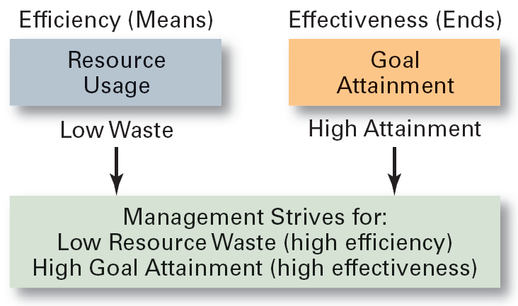
Efficiency and Effectiveness in Management
www.hndit.com
(Robbins and Coulter, 2012)

Slide 16
High Performing Organisations are Effective and Efficient
www.hndit.com
(John R. Schermerhorn)

Slide 17
Productivity
www.hndit.com
Productivity is the relationship between the output generated by a production or service system and the input provided to create this output.
Productivity = Efficiency + Effectiveness

Slide 18
Management – as a Process
www.hndit.com
Planning
Organizing
Leading
Controlling

Slide 19
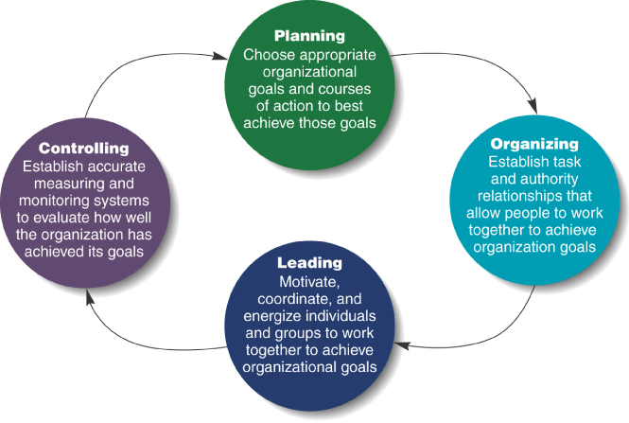
Four Functions of Management
www.hndit.com
(Jones and George, 2008)

Slide 20
Management Is it a Science or an Art?
www.hndit.com

Slide 21
www.hndit.com
Management as a Science
Science is a body of knowledge pertaining to a specific field of study. It contains theories, principles and facts.
Management as an Art
Art implies the application of knowledge and skills to bring about the desired results.
Management is both a science as well as an art.
Science(theory) and art (practice) are both essential for the success of management.

Slide 22
Why Management?
www.hndit.com
To maximise the utilisation of scarce resources
To face the increasing competition for inputs and outputs
To enhance the quality of the products and services
To adopt/plan for the changes in the business environment
The ultimate aim of management is to enhance the organisational productivity and performance.

